Slide 1
LANDFORMS
Ms. Sinclair’s Saturday Science

Slide 2
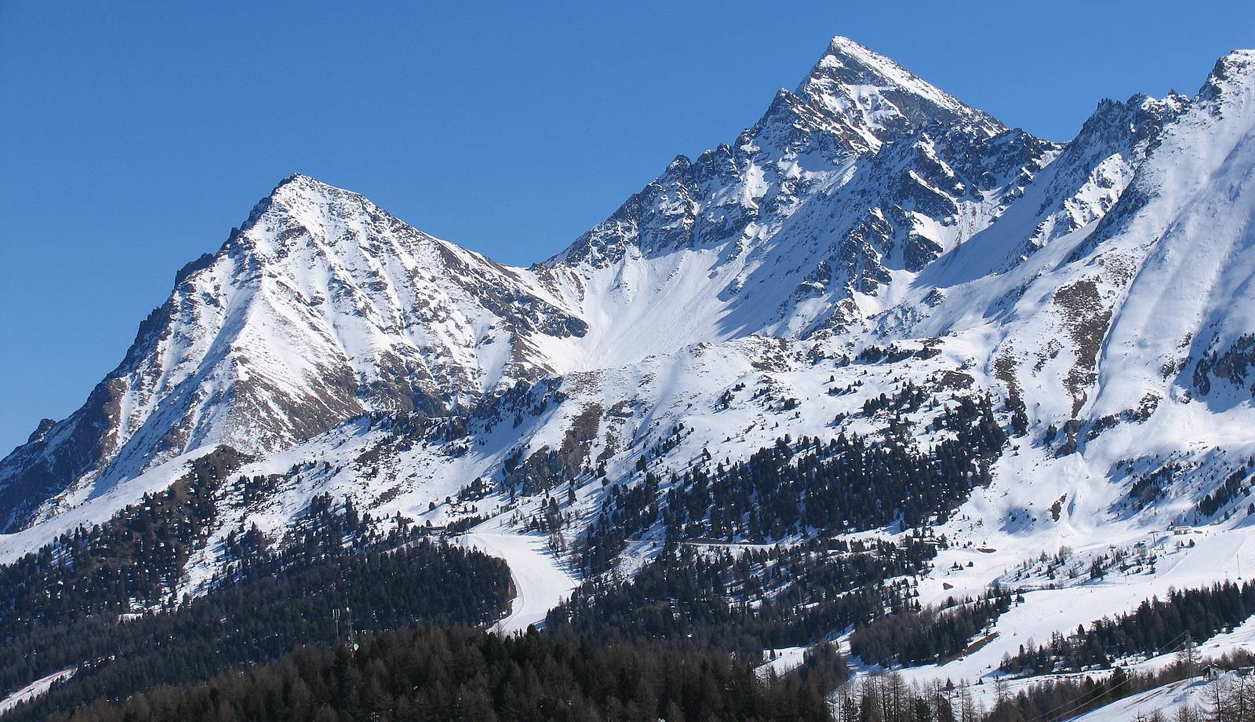

Slide 3
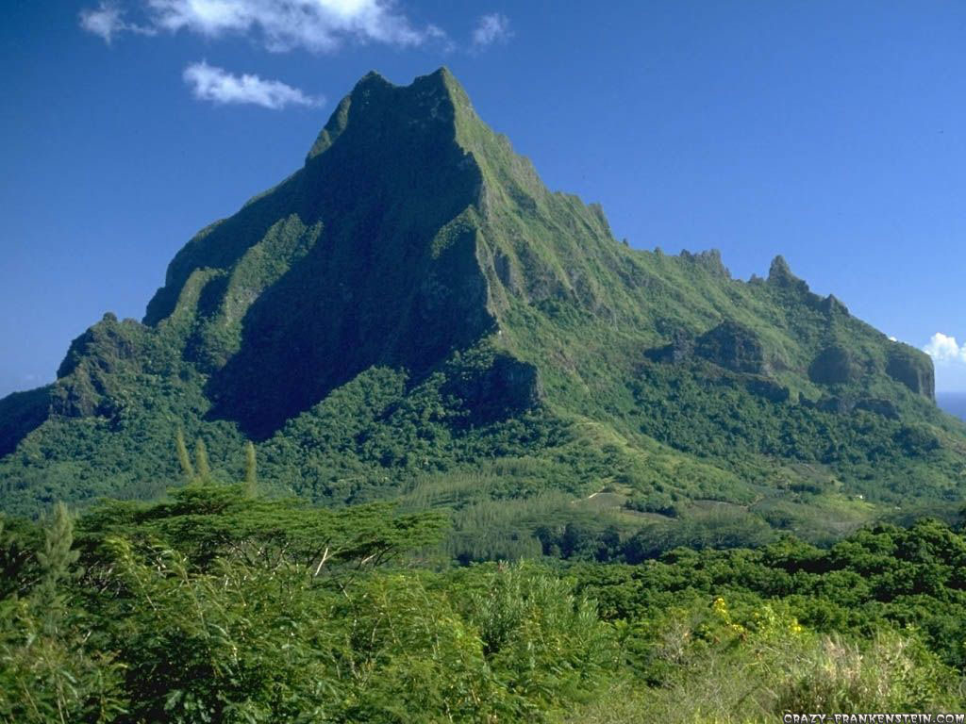

Slide 4
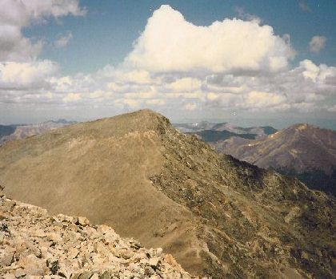

Slide 5
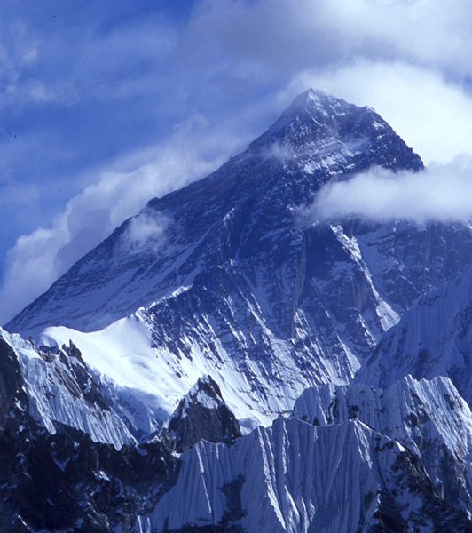
Mountains
Do you know what these are?
How did you know?
What are some similar characteristics?
Some different characteristics?
Mt. Everest

Slide 6
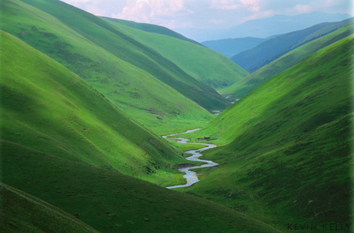

Slide 7
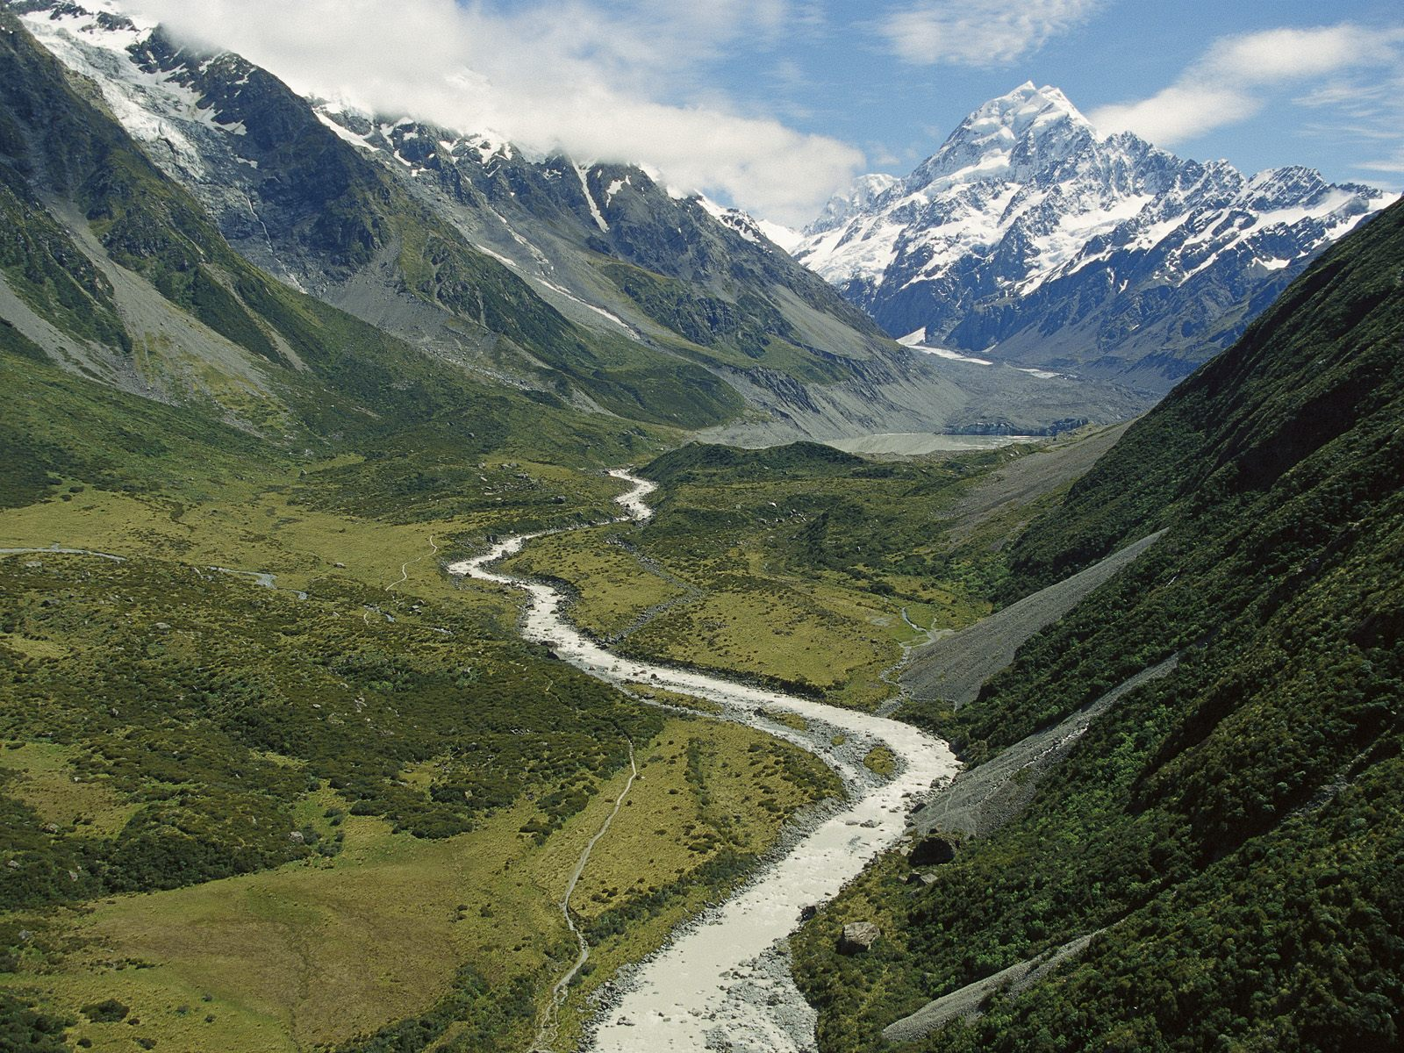

Slide 8
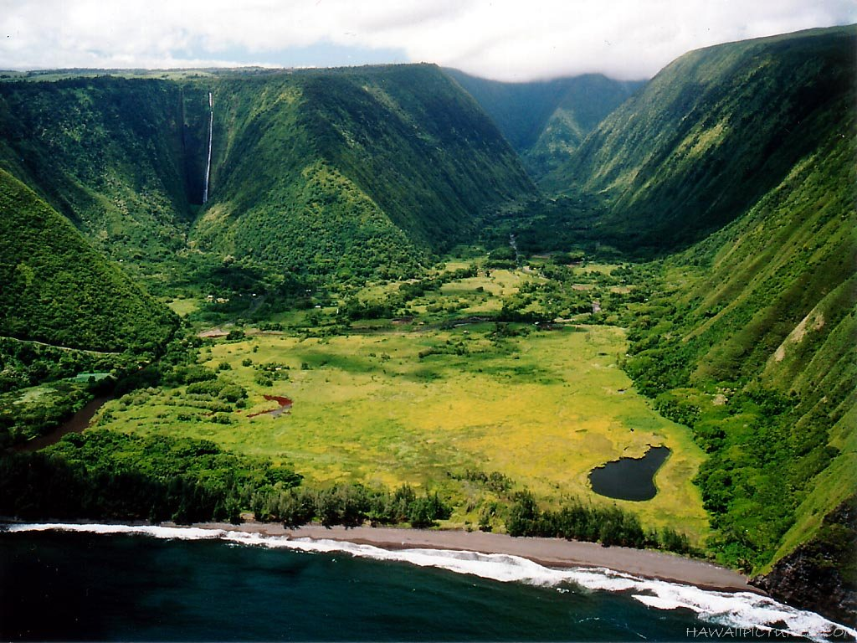

Slide 9
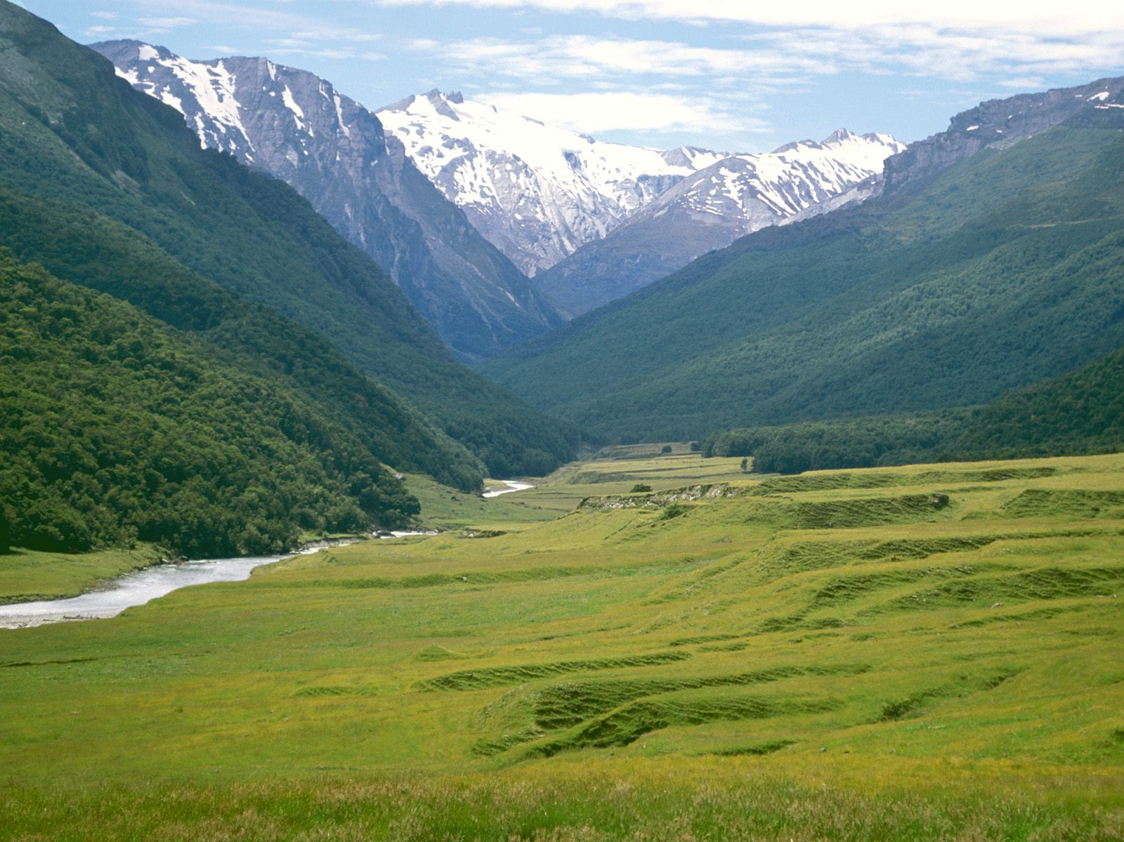
Valley
Do you know what these are?
How did you know?
What are some similar characteristics?
Some different characteristics?

Slide 10
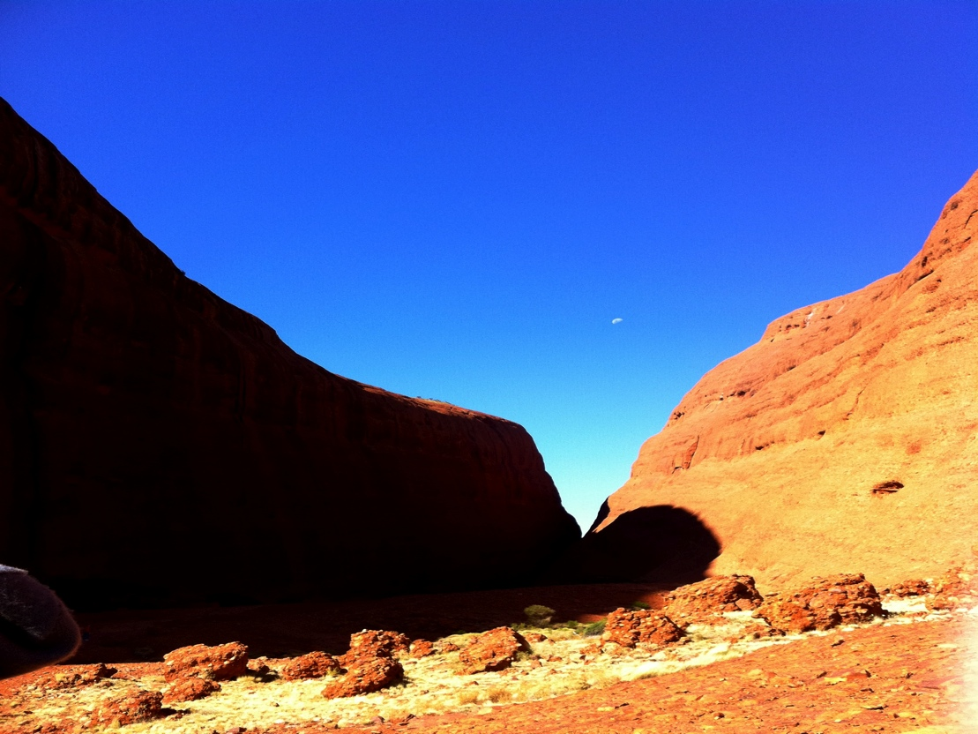
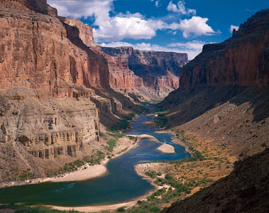
What’s the difference?

Slide 11
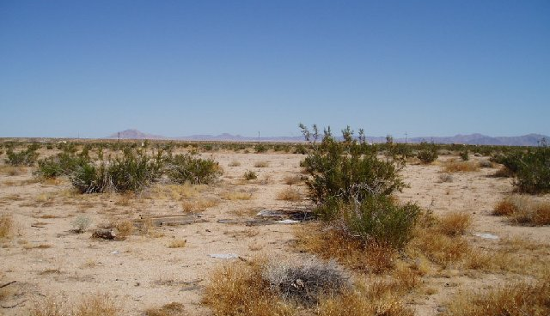

Slide 12
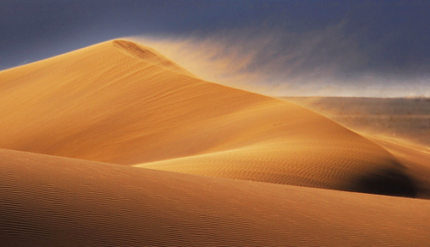

Slide 13
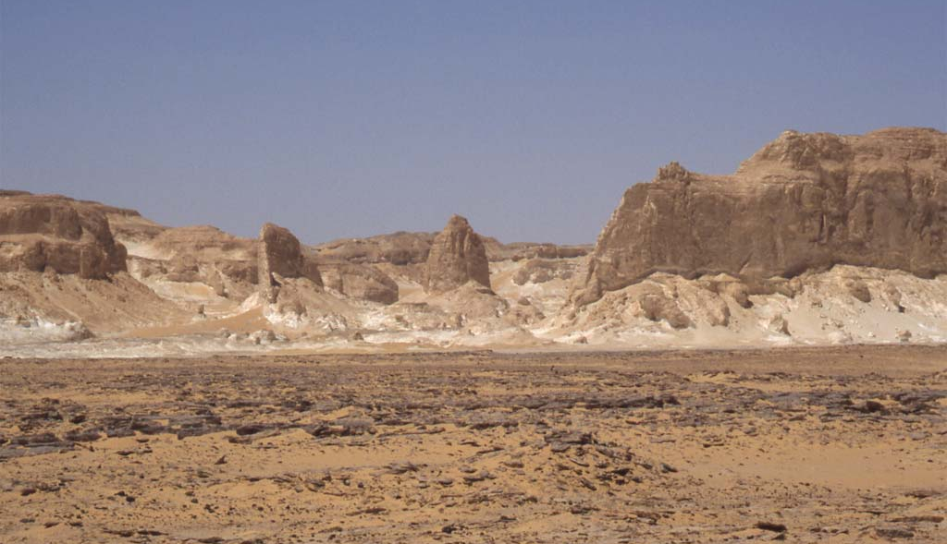

Slide 14
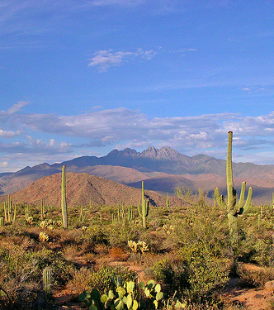
Desert
Do you know what these are?
How did you know?
What are some similar characteristics?
Some different characteristics?

Slide 15
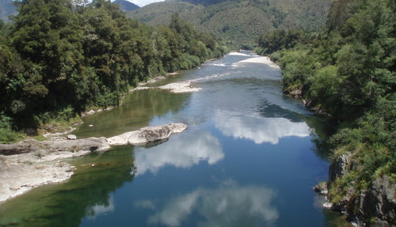

Slide 16
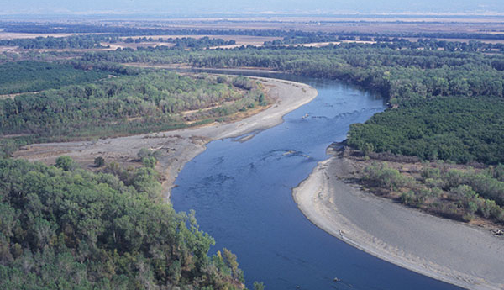

Slide 17
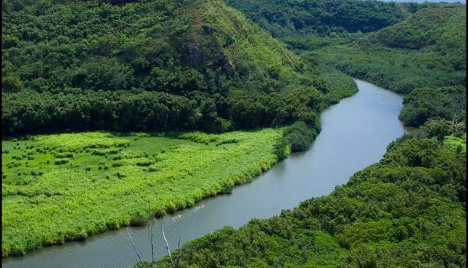

Slide 18
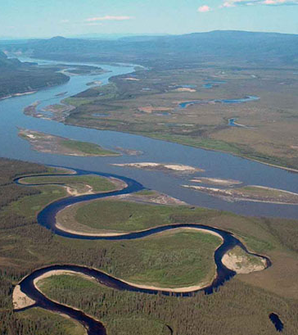
River
Do you know what these are?
How did you know?
What are some similar characteristics?
Some different characteristics?

